Slide 1
Outline
Anurag Group Of Institutions
Computer Science And Engineering
Node-RED
Technical Seminar By:
Name: Gajam Nikhil
Roll No:19H61A05D5
Guide: Mr. G. Balram
(Asst. Professor)
Department Of CSE

Slide 2
Contents
Abstract
Introduction
Existing system and Drawbacks
Methodology
Design (Architecture)
Applications/Uses
Conclusion
References

Slide 3
Abstract
Node-RED is used to connect, develop and integrate different platforms and functions together with minimal coding. Node-RED is a flow-based development tool for visual programming developed originally by IBM for wiring together hardware devices, APIs and online services as part of the Internet of Things. Node-RED provides a web browser-based flow editor, which can be used to create JavaScript functions and many more.

Slide 4
Introduction
Node-RED is an open source visual editor that allows programmers of any level to rapidly interconnect Physical I/O, Cloud-based Systems, Databases, and most API’s in any combination and it is widely used in Internet of Things(IoT) and Industrial Internet of Things(IIoT). And this works in wide variety of the computers with Windows, Mac OS, Linux. And it also works with Raspberry Pi and other Node-RED compatible servers. This Node-RED a is event driven system.

Slide 5
Existing System And Drawbacks
Currently the applications created using Node-RED will not support multitenant processing and it will be a little bit time consuming to locate the needed nodes.
Some of the existing approaches and its drawbacks:
Right now there is no proper mechanism to control the overloading problem.
All the Node JS limitations will also apply to this Node-RED because it is implemented mostly using node js.
And it needs more processing power if the application is big which needs more money.
It is currently not suitable for very heavy enterprise use.

Slide 6
Methodology
Node-RED is a new tool which got started in 2013 by IBM.
It contains nodes and connections which can act as operation, activity flow.
It is an open source platform which means new changes will be made very oftenly and with each and every change this tool gets even better and will have much more functionalities and all these new updates will be made by the developers across the world.
As any new emerging technology it gets better by time.

Slide 7
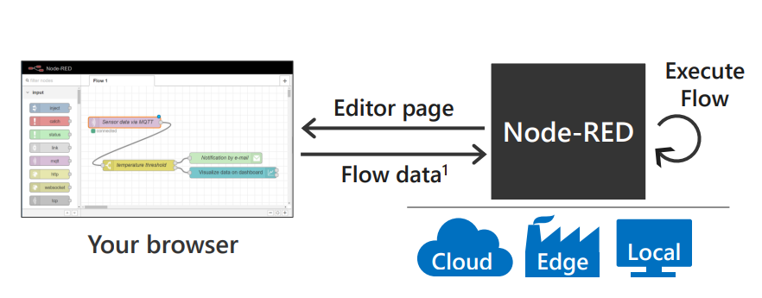
Methodology Cont.

Slide 8
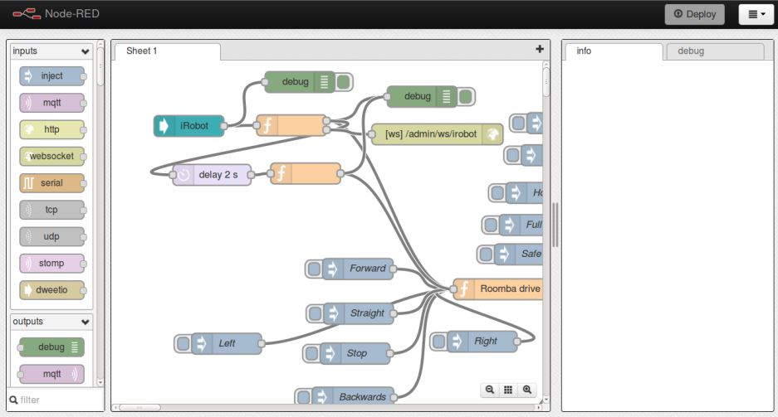
Methodology Cont.

Slide 9
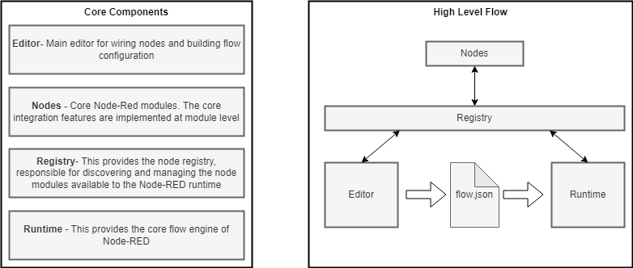
Design (Architecture)

Slide 10
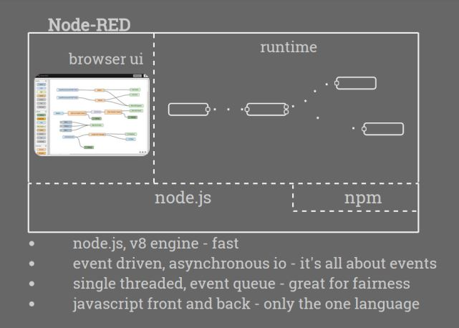
Design (Architecture) Cont.

Slide 11
Design (Architecture) Cont.
When using Node-RED we need to do every operation using nodes and these nodes serves different functionalities and we can install new nodes and also create publish our own nodes.
Registry will contain all the settings required to start using the node-red.
Editor is used to represent the flow of operations graphically.
The dynamic flow.js will be created when we start to add new nodes to perform operations.
Runtime is the core engine which will make the whole process possible.

Slide 12
Applications
Applications:
Space Station Tracking Application – Points space station in map using get location api.
Messaging Application – Server, Private chatting applications.
Monitoring Application – Stock, Revenue, Weather monitoring applications.
Device Controlling Application – Using Raspberry Pi to connect and control other macro devices.
Message Queuing Telemetry Transport (MQTT) & HTML Applications – Publish-Subscribe, Client-Server model applications.

Slide 13
Uses
Uses:
It is simple to use and deploy.
It is a lightweight proof of concept runtime.
Capable of creating backend and frontend together.
It is powerful enough to create a very big application.

Slide 14
Conclusion
Node-RED is an open source tool which is used to combine more than one technology together and we can achieve this with minimal code.
It will be easy for the beginners to start working with the Node-RED.
Node-RED is an event driven and fast platform which is totally updated and maintained by contributors and it is single threaded.
It can be used to create small and big applications used in various platforms.
It is a constant updating and growing tool which is going to get many other features often and constantly.

Slide 15
References
Lekić, Milica, and Gordana Gardašević. "IoT sensor integration to NodeRED platform." 2018 17th International Symposium INFOTEHJAHORINA (INFOTEH). IEEE, 2018.
Kodali, Ravi Kishore, and Arshiya Anjum. "IoT based home automation using node-red." 2018 Second International Conference on Green Computing and Internet of Things (ICGCIoT).
Toc, Silviu-Iulian, and Adrian Korodi. "Modbus-OPC UA Wrapper using Node-RED and IoT-2040 with application in the water industry." 2018 IEEE 16th International Symposium on Intelligent Systems and Informatics (SISY). IEEE, 2018.
Sicari, Sabrina, Alessandra Rizzardi, and Alberto Coen‐Porisini. "Smart transport and logistics: A Node‐RED implementation." Internet Technology Letters 2.2 (2019).
Ferencz, Katalin, and József Domokos. "IoT Sensor Data Acquisition and Storage System Using Raspberry Pi and Apache Cassandra." 2018 International IEEE Conference and Workshop in Óbuda on Electrical and Power Engineering (CANDO-EPE). IEEE, 2018.
Tabaa, Mohamed, et al. "Industrial Communication based on Modbus and Node-RED." Procedia computer science (2018).

Slide 16
Thank You

